Slide 1
Students’ Fairs carried out at OSENU
Odessa State
Environmental University
Notes:
Морская рябь
(простой)
Примечание. Этот видеошаблон оптимизирован для приложения Microsoft PowerPoint 2010.
В PowerPoint 2007 видеоэлементы также воспроизводятся, однако при показе слайдов все содержиое, перекрывающее области видео, будет закрыто видеороликом.
В PowerPoint 2003 видео не воспроизводится, но рамки видеоэлементов остаются на месте в виде статичных изображений.
Видео
Воспроизводится автоматически после каждого перехода между слайдами.
Длится 15 секунд.
Воспроизводится циклически.
Чтобы добавить слайды или изменить макет, выполните указанные ниже действия.
Чтобы добавить слайд, на вкладке Главная в группе Слайды щелкните стрелку под кнопкой Создать слайд и в разделе Тема с движущимся фоном выберите макет.
Чтобы изменить макет существующего слайда, на вкладке Главная в группе Слайды нажмите кнопку Макет и выберите нужный вариант.
Другие анимированные элементы
Любая аниация начинается после перехода к следующему слайду и запуска фонового видео.
Макеты с видеоэффектами
Макеты «(Зеленый) заголовок и содержимое» и «(Фиолетовый) заголовок и содержимое» создаются путем наложения цветов на видео.
Выделив видео, на вкладке Работа с видео откройте вложенную вкладку Формат, в группе Настройка нажмите кнопку Цвет и выберите вариант Оранжевый, светлый контрастный цвет 6 (третья строка, седьмой элемент слева) или Темно-бирюзовый, светлый контрастный цвет 5 (третья строка, шестой элемент слева).

Slide 2
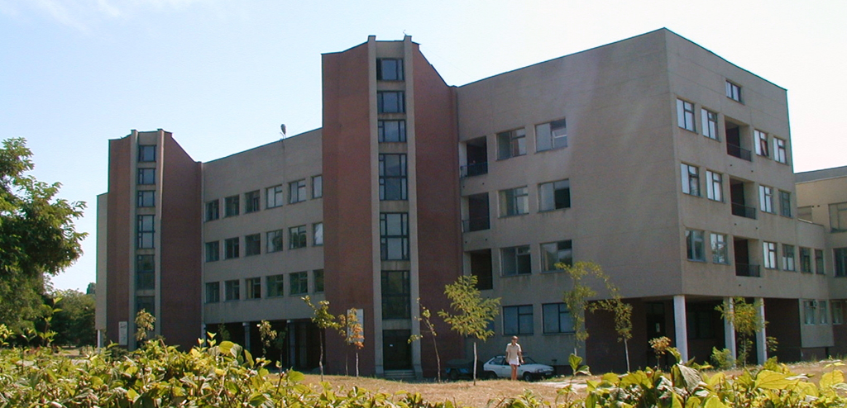
OSENU Career Center
is a comprehensive information and methodical subdivision of the University, which represents the interests of Odessa State Environmental University in public and other institutions on the issues covered by its terms of reference..

Slide 3
OSENU Career Center
The main tasks and scope of activities of the Center are as follows:
implementation of measures on assessment of market demand for graduates of various directions of training, specialities and specializations with the aim of making an estimation of university quotas for training personnel in the field
establishment of relations with enterprises, institutions and organizations, the major employers of OSENU graduates, in various regions of Ukraine
drawing up and filling out the forms on placement of university graduates

Slide 4
OSENU Career Center
organization and implementation of monitoring for employment of university graduates and their subsequent career development in a speciality
rendering services to the university students and graduates in the form of consultations, testing, relevant sociological interviews and organization of the students’ meeting with employers and previous OSENU graduates
setting up and maintenance of a database on job vacancies at enterprises
organization of interviews with prospective employers for the university students and graduates

Slide 5
OSENU Career Center
assistance to employment of full-time students in temporary / part-time jobs during their studies at the University
giving lectures and talks to the students on the issues of employment, as well as training them in the course of additional specialized optional classes on practical guidelines and helpful hints for writing a professional résumé / CV, having an interview for a job, taking a test, building and projecting a professional image
organization and implementation of profile methodological workshops, conferences etc.
issuance of information bulletins, newsletters etc

Slide 6
Ukrainian Hydrometeorological Center The Hydrometeorological Center for the Black Sea and the Sea of Azov Department of Agricultural Meteorology
The main tasks of the Department of Agricultural Meteorology are:
research and assessment of patterns for development of meteorological and climate conditions of agricultural production in the geographical perspective and with the time
quantitative assessment of influence of meteorological factors on crop development, condition and productivity
forecasting the yield in basic crops
efficient provision of agricultural production entities with agrometeorological data

Slide 7
The Hydrometeorological Center for the Black Sea and the Sea of Azov Department of Agricultural Meteorology
substantiation for the zoning of new varieties and hybrids of crops as well as the means for maximum use of climate resources in order to increase productivity of agriculture;
substantiation for the differentiated application of agricultural methods, with the current and the expected weather conditions, mechanization and chemicalization of agricultural production taken due account of.
Provision of public authorities, the Ministry of Agro-Industrial Complex, organizations and departments of the agricultural sector with agrometeorological data.

Slide 8
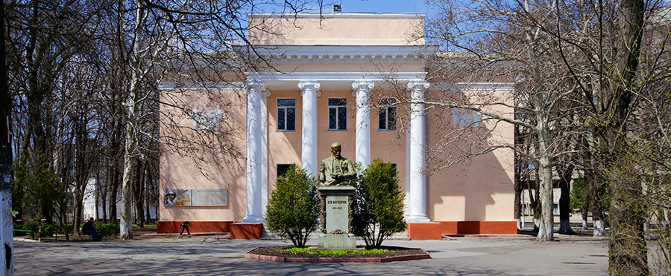
The Odessa Plant Breeding and Genetics Institute Department of Resistance to Abiotic Factors
Identification of physiological characteristics of the plants’ resistance and adaptive capacity.
Selection of plants with the characteristics which provide resistance to abiotic factors (drought, salinity, oxidative stress)

Slide 9
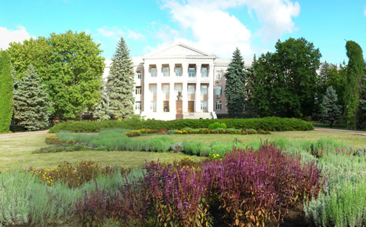
Institute of Viticulture and Wine-Making named after V. Ye. Tairov, NAAS of Ukraine
Departments of:
Molecular Genetics and Phytopathology
Selection, Genetics and Ampelography
Ecology of Vine
Mechanization
Viticulture
Vine Nursery and Reproduction
Research into the Issues of Intellectual Property, Marketing and Innovations
Wine-Making
Laboratories of:
Virology and Microbiology
Agricultural Chemistry
Agroclimatology
Chemical Analysis

Slide 10
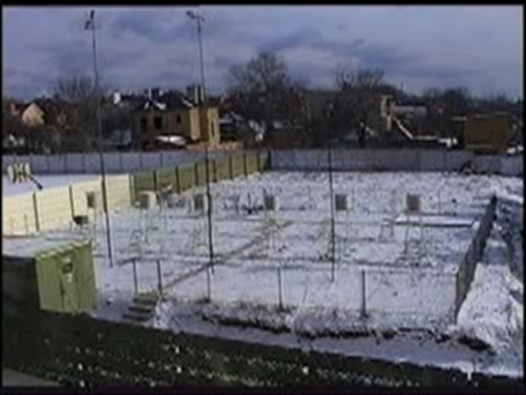
Laboratory of Agroclimatology
Scientific and Practical Tasks:
Research into the patterns of spatio-temporal variability of agroclimate resources in the North Black Sea Region as applied to viticulture;
Assessment of unfavorable agrometeorological conditions causing the stress state of vine in the vegetation and the winter dormancy periods;
Microclimate zoning of a territory according to the conditions of frost and light frost danger as well as the ones of heat supply for various varieties of vine;
Betterment of methods for mapping agroclimate resources with regard to a microclimate;
Optimization of the location for vine plantations with environmental conditions in Ukraine taken account of.
Development and compilation of an ‘Agroclimate resources’ unit for the Cadastre of Vineyards in Ukraine.

Slide 11
Laboratory of Agroclimatology
A branch of the Department of Agricultural Meteorology and Agrometeorological Forecasting of the Hydrometeorological Institute of Odessa State Environmental University is created and functions on the basis. It is at the laboratory that undergraduate and graduate students of the University undergo their pre-graduation practice and work on the diploma projects / theses, the topics for which are within the subject area of the Department of Vine Ecology.

Slide 12
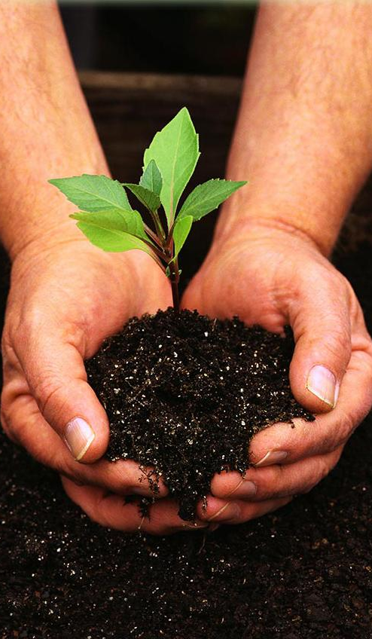
Laboratory of Plant Protection
Main Areas of Research:
Monitoring phytosanitary condition of vine plantations.
Research into peculiarities of vine disease development (blackspot, infectious drying, Eutypa dieback, Esca (Apoplexy), powdery mildew (Oidium), grey rot etc.).
Vermin propagation (Lobesia botrana (the European grapevine moth), acaridans, soil vermin etc.).

Slide 13
Laboratory of Plant Protection
Development of a system of measures to exert control of them
Development of technologies for protection of vine planting stock
Assessment of the efficiency of means for vine protection (fungicides, insecticides, acaricides, biologicals, hormonal agents etc.) from diseases and vermin.
Research into the biological effectiveness of plant protection means

Slide 14
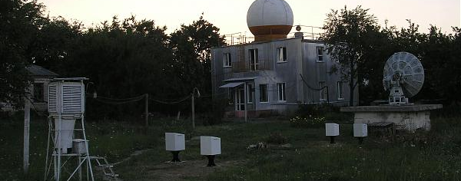
Ukrainian Research Hydrometeorological Institute
research into patterns for formation of climate, weather, hydrological processes, agrometeorological conditions, hazardous and elemental hydrometeorological phenomena; development of models, methods, and technologies for forecasting of them
study of patterns for physical processes in the atmosphere and fundamental research into active influence on meteorological processes and phenomena

Slide 15
Ukrainian Research Hydrometeorological Institute
development of methods and facilities for hydrometeorological observations, computer technologies for obtaining, storage, treatment, analysis and generalization of the hydrometeorological data, and formulation of national normative documents on Hydrometeorology
research, assessment and forecasting of hydrometeorological and hydrochemical regimes of the Black Sea and the Sea of Azov
research and prognostication of chemical and radiation state of the environment, study of its being influenced by natural and technogenic factors

Slide 16
Institute of Agroecology The National Academy of Agrarian Sciences of Ukraine
Main Areas of Research:
substantiation for selection methodology at singling out a strategy of sustainable development for the agroecosystems in Ukraine
rational nature use and control of the natural environment;
development of scientific basis for agroecological monitoring
conservation and recreation of agrobiological diversity and development of an environmental safety system
assessment and forecasting for environmental consequences of employing technologies of various kinds in an agricultural production

Slide 17
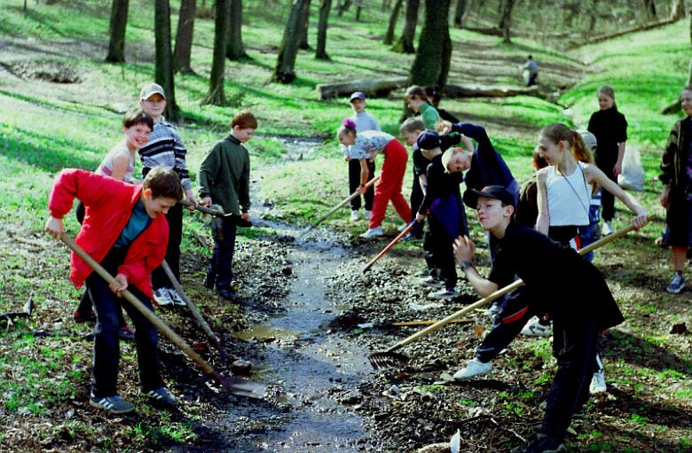
Environmental Organizations
National Ecological Center of Ukraine
Ukrainian Society for Nature Conservation
Ukrainian Youth Environmental League
The Nature Protection and Restoration Fund 'Nature Heritage Fund' named after Prof. I.I.Puzanov
All-Ukrainian Committee on UNEP Activities Support (UkrUNEPCom)
All-Ukrainian Environmental League

Slide 18
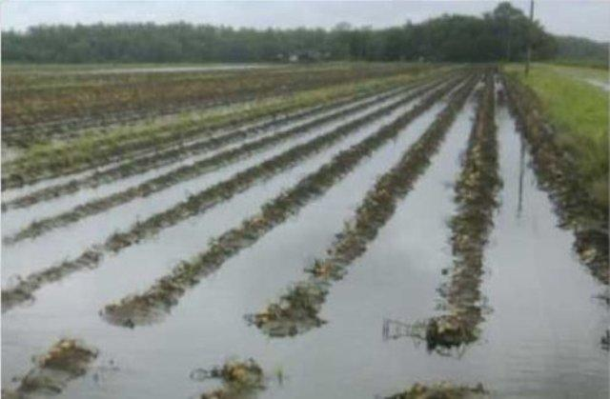
Thank you!
Odessa
State
Environmental
University

